Slide 1

Basic Details of the Team and Problem Statement
Ministry/Organization Name/Student Innovation: Ministry of Jal Shakti
PS Code: SIH1287
Problem Statement Title: Use of Digital Technology to calculate water footprints for different daily use items.
Team Name: Clueless Coder
Team Leader Name: Dharma Kamleshbhai Patel
Institute Code (AISHE):U-0136
Institute Name: Gujarat University
Theme Name : Clean And Green Technology

Slide 2
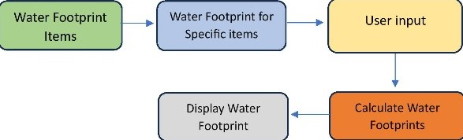

Idea/Approach Details
Add process flow chart or simulated image of prototype or any relevant image related to your idea
Describe your idea/Solution/Prototype here:
A water footprint calculator can be a valueable tool for various use cases , helping individuals and organizations understand and manage their water consumption.
-Individuals can use a water footprint calculator to estimate their water usage for daily activities such as showering , cooking , laundry and gardening.
-Municipalities can employ water footprint calculators to estimate water usage patterns within their communities. This information can guide water resource management , infrastructure investment decisions and water conservation campaigns.
Describe your Technology stack here:
-language : python

Slide 3
Idea/Approach Details
Describe your Use Cases here
Describe your Dependencies / Show stopper here
-Individual Household Usage
-Appliance and Fixture Evaluation
-food choices-Product manufacturing
-Agricultural Practices
-Supply chain Analysis
-Educational tools
-Municipal water management
-Event Planning
-Corporate Sustainability Reporting
-Product Labeling-Policy development
Water Use Data
Water Availability Data
Population and Consumption Data
Product and Activity Information
Agricultural usage Data

Slide 4
Team Member Details
Team Leader Name: DHARMA KAMLESHBHAI PATEL
BSc: Data Science: Year(II)
Team Member 1 Name: KESHA PARAS PATEL
BSc: Data Science: Year(II)
Team Member 2 Name: DISHEN ALPESHBHAI MULANI
BSc: Data Science: Year(II)
Team Member 3 Name: PREM MANISHKUMAR PATEL
BSc: Data Science: Year(II)
Team Member 4 Name: KARUNESH YOGESHBHAI PATEL
BSc: AIML Year(II)
Team Member 5 Name: SAHIL GIRISHKUMAR BAROT
BSc: AIML Year(II)
Team Mentor 1 Name: Type Your Name Here
Category (Academic/Industry): Expertise (AI/ML/Blockchain etc): Domain Experience (in years):
Team Mentor 2 Name: Type Your Name Here
Category (Academic/Industry): Expertise (AI/ML/Blockchain etc): Domain Experience (in years):

Slide 5
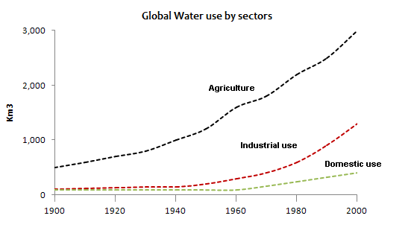
Important Pointers
Please ensure below pointers are met while
water availability and consumption patterns vary greatly by region.
easy for users to input data, view results, and understand the calculator's methodology.
Water footprint vary greatly by variation in daily water usage.

